Slide 1

C/C++
Statements, Functions, Data types / Structures

Slide 2
Table of contents Index / Agenda
Statements
Flow Control
Arrays
Initialization
Multidimensional
Character sequences
Data Structures
Typedefs
Enums
Unions
Author

Slide 3
Statements
Statements:
Represent each individual instruction given to the program.
They always end with a semicolon (;).
Are executed sequentially .
During its process, a program may repeat segments of code, or take decisions and bifurcate. For that purpose, C++ provides flow control statements that serve to specify what has to be done by our program, when, and under which circumstances.

Slide 4
Flow Control – If
int main()
{
// declare local variable
int a = 10;
// check a boolean condition
if(a == 10)
printf("a = %d", a);
else
printf("other value");
return 0;
}
The if keyword is used to execute a statement or a block of code if the expression inside the brackets evaluates to true.
If the expression evaluates to false the statement or block of code is simply ignored.

Slide 5
Flow Control – If
int n = 5;
if (n)
printf("Hello 1.");
int m = -5;
if (m)
printf("Hello 2.");
int k = 0;
if (k)
printf("Hello 3.");
(1)
In C/C++, any non-zero expression evaluates to True.
E.g. only the code in the third image does not print “hello”
(2)
An if keyword can be followed by an optional else keyword, which executes if the Boolean expression is false.
An if statement executes the first line of code following the if statement or the first code block (encapsulated by curly braces { } ).
(3)

Slide 6
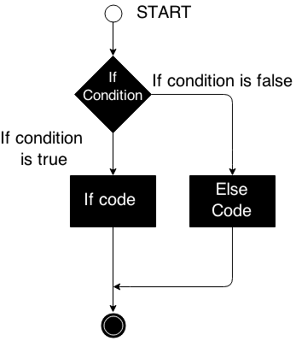
Flow Control – If
// local variable declaration
int a = 100;
// check a Boolean condition
if ( a == 10 )
{
// if condition is true then print the following:
cout << "Value of a is 10 " << endl;
}
else if ( a == 20 )
{
// if else if condition is true
cout << "Value of a is 20 " << endl;
}
else
{
// if none of the conditions are true
cout << "Value of a is not matching." << endl;
}
cout << "Exact value of a is: " << a << endl;

Slide 7
Flow Control – Switch
enum Color {red=1, green, blue, white, black};
Color selector = green;
switch (selector) {
case red: cout << "red"; break;
case green: cout << "green"; break;
case blue: cout << "blue"; break;
// ...
default: cout << " other color";
}
A switch statement selects which block of code to execute based on the value of an integral expression.
The switch statement compares the value of selector to each integral value.
If no match is found, the default case is executed.
Every case needs to end with a break keyword. This causes the program to jump to the end of the switch body.
If no break keyword is encountered the program continues to the next case until the end of the switch body or the first break command is encountered.

Slide 8
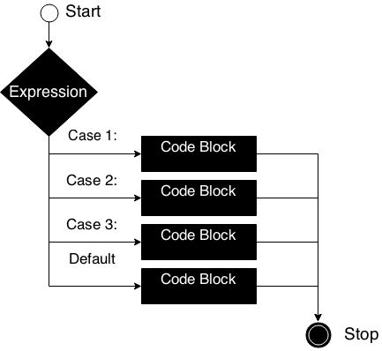
Flow Control – Switch
char choice = 'a';
switch (choice) { // evaluates to an integer type
case 'a': std::cout << "You chose 'a'"; break;
case 'b': std::cout << "You chose 'b'"; break;
case 'c': std::cout << "You chose 'c'"; break;
default: cout << " Try again!";
}
// program prints: You chose 'a'

Slide 9
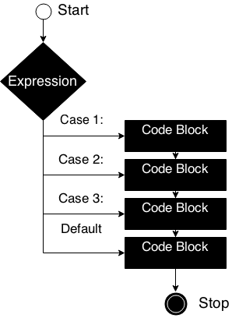
Flow Control – Switch
char choice = 'a';
switch (choice) { // evaluates to an integer type
case 'a': std::cout << "You chose 'a'";
case 'b': std::cout << "You chose 'b'";
case 'c': std::cout << "You chose 'c'";
default: cout << " Try again!";
}
// program prints: You chose 'a'You chose 'b'
// You chose 'c'Try again!

Slide 10
Flow Control – While and do-while
// initialize variable
int n = 0;
// keep repeating the code block
// until condition is met
while ( n < 10 )
{
std::cout << n << std::endl;
n++; // increment the number
}
While, do while and for are used for looping
While evaluates the condition before executing the code.
For evaluates the condition before executing the code.
Do-while executes the code and then evaluates the condition.

Slide 11
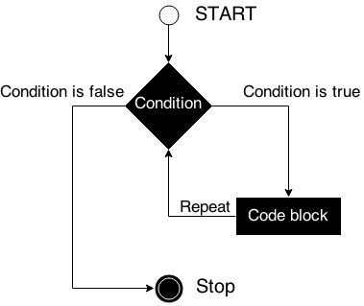
Flow Control – While
// initialize variable
int n = 0;
// keep repeating the code block
// until condition is met
while ( n < 10 )
{
std::cout << n << std::endl;
n++; // increment the number
}

Slide 12
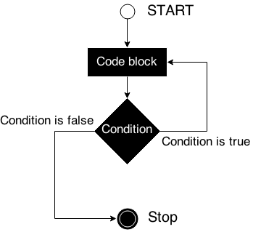
Flow Control – Do-while
int n = 10;
do
{
std::cout << n << std::endl;
// decrement number;
n--;
// keep repeating until
// condition is met
} while (n < 10 && n > 0);
Do-while assures the code will execute at least once.

Slide 13
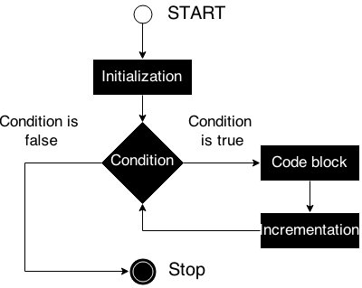
Flow Control – For
All of the steps in a for statement(initialization, evaluation and incrementing) are optional.
// initialize `i`
// evaluate condition
// increment
for( int i = 0; i<255; i++)
{
// print ASCII characters
std::cout << char(i) << std::endl;
}

Slide 14
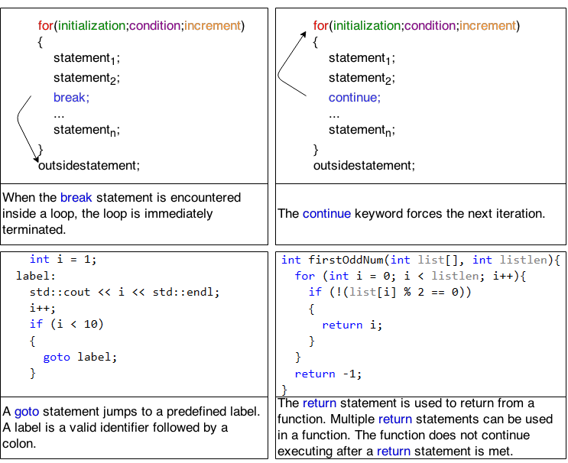
Jump Statements
Not to be used
in C++ Applications

Slide 15
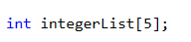
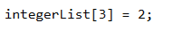
Arrays
An array is a series of elements of the same type placed in contiguous memory locations that can be individually referenced by adding an index to a unique identifier.
You can access an array value through the subscript operator.
Unique identifier
Data type the array will hold
Allocated size

Slide 16
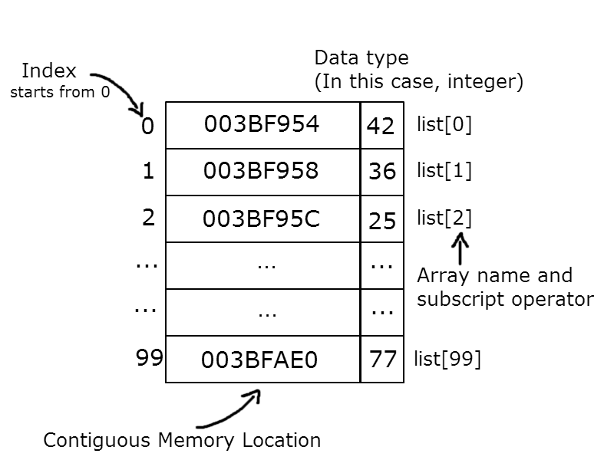
Arrays

Slide 17
Arrays. Initialization.
(1)
int aIntegerList[5];
int main()
{
int bIntegerList[5];
for (int i = 0; i < 5; i++)
{
// aIntegerList declared globaly, prints 0's
std::cout << aIntegerList[i] << std::endl;
// bIntegerList declared inside local scope
// prints junk values
std::cout << bIntegerList[i] << std::endl;
}
int cIntegerList[5] = {0, 2, 4, 6, 8};
}
When declaring a global or static array, the values contained by the array will be automatically initialized to 0, (1).
When declaring an uninitialized array inside a local scope (2), the values contained by the array are undetermined.
An array can also be initialized using the brackets operator. (3)
(2)
(3)

Slide 18
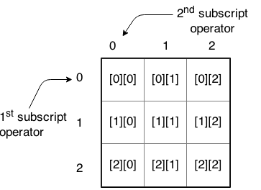
Arrays. Multidimensional.
Multidimensional arrays can be described as "arrays of arrays". For example, a bidimensional array can be imagined as a bidimensional table made of elements, all of them of a same uniform data type.
// multidimensional array declaration
// with uniform initialization
int integerList[2][2] = { {2,3}, {4,5} };
for (int i = 0; i < 2; i++)
{
for (int j = 0; j < 2; j++)
std::cout << integerList[i][j] << std::endl;
std::cout << std::endl;
}

Slide 19
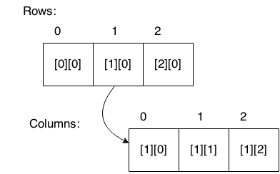
Arrays. Multidimensional.
Alternate representation:

Slide 20
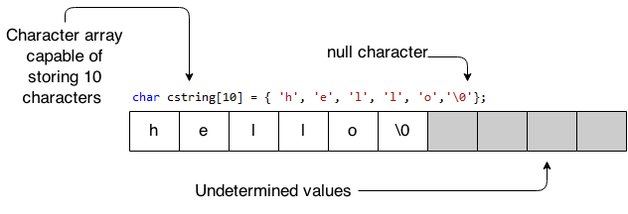
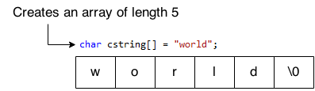
Arrays. Character Sequences.

Slide 21
Arrays. Character Sequences. Initialization.
char cString[10] = { 'h', 'e', 'l', 'l', 'o', '\0'};
// does not automatically add null char
char s1[] = { 'h', 'e', 'l', 'l', 'o' };
// automatically adds null char
char s2[] = "hello";
// prints random number
cout << strlen(s1) << endl;
// prints array length - 5
cout << strlen(s2) << endl;
This type of initialization is only available at declaration.
s1 = { 'w', 'o', 'r', 'l', 'd' }; //not valid
s1 = "world"; //not valid

Slide 22
Arrays. Character Sequences. Operations.
Name | Description
strcpy_s(s1, s2) | Copies s2 into s1
strcat_s(s1, s2) | Concatenates s2 onto the end of s1
strlen(s1) | Returns the length of s1
strcmp(s1, s2) | Returns 0 if s1 and s2 are the same; less then 0 if s1 < s2; greater then 0 if s1 > s2
strchr(s1, ch) | Returns a pointer to the first occurrence o ch in s1
strstr(s1, s2) | Returns a pointer to the first occurrence of s2 in s1

Slide 23
Arrays. Character Sequences. Operations.
// if strcmp return 0, the char arrays are equal
if ( !strcmp(s1, s2) )
cout << "Arrays are equal." << endl;
// prints the length of s1
cout << strlen (s1) << endl;
// concatenate strings
strcat_s(s1, s2);
// s1 now contains "HelloWorld"
cout << s1 << endl;
// copy s1 into s2
strcpy_s(s2, s1);
// s2 now holds "HelloWorld"
cout << s2 << endl;
// find a char in a string
if ( strchr(s1, 'H') )
cout << "H is in s1" << endl;
// find a char sequence (substring) in a string
if ( strstr(s1, "Hello") )
cout << "`Hello` is in s1" << endl;
If you intend to use different language specific commands without specifying for each one the containing namespace, you have to declare at the beginning of the file the use of that namespace.
Above code example needs declaring the use of ‘std’ namespace:
using namespace std;
Conclusion:
Instead of “std::cout” you can use directly “cout”

Slide 24
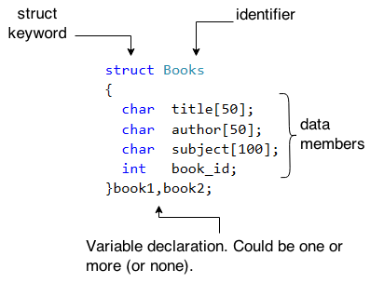
Data Structures
A data structure is a group of data elements grouped together under one name. These data elements, known as members, can have different types and different lengths. Data structures can be declared in C++ using the following syntax:

Slide 25
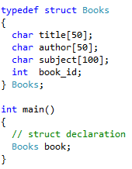
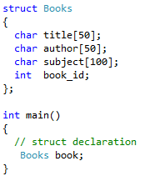
Data Structures
C style Declaration:
C++ style Declaration:

Slide 26
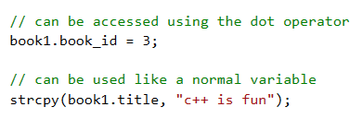
Data Structures
Accessing Structure Members:
To access any member of a structure, you can use the member access operator (.)

Slide 27
Data Structures
using namespace std;
// declare data structure
struct Mix {
int a;
char c;
double d;
};
int main()
{
// initialize the structure
Mix myMix = { 5, 'a', 2.5 };
// access each item in the structure
cout << myMix.a << endl; // print: 5
cout << myMix.c << endl; // print: a
cout << myMix.d << endl; // print: 2.5
return 0;
}
You can initialize every member of a structure using universal initialization (curly braces initialization { } )
You can access each member using the member access operator ‘.’

Slide 28
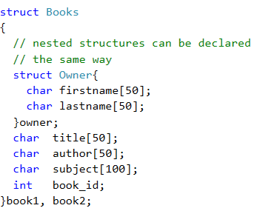
Data Structures
A valid member of a structure can be another structure.
Nested structures can be accessed the same way as a normal member.

Slide 29
Data Structures
using namespace std;
struct Time{
int hour, minute;
double second;
// declare member functions
void printTime(){
cout << hour <<':' << minute << ':' << second;
}
};
int main()
{
// Initialize current time:
Time currentTime = {9, 38, 45.6};
currentTime.printTime(); // prints 9:38:45.6
return 0;
}
In addition to member data, structures can also contain member functions.

Slide 30
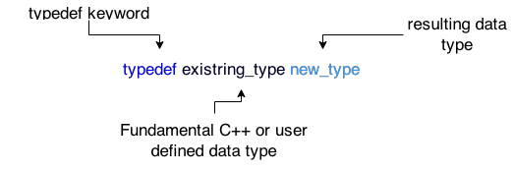
Typedefs
The typedef declaration provides a way to create an alias that can be used anywhere in place of a (possibly complex) type name.
Typedef declaration:

Slide 31
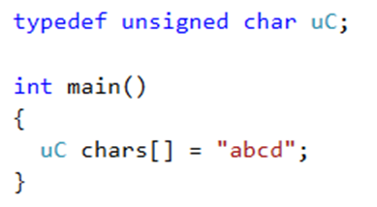
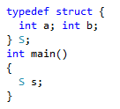
Typedefs
When to use typedefs:
Creating a type out of a compound type:
Along with struct declaration, in order to avoid writing struct <struct name>:

Slide 32
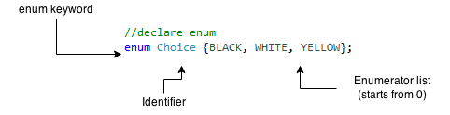
Enums
An enumerated data type is a way of attaching names to numbers, thereby giving more meaning to anyone reading the code. The enum keyword automatically enumerates any list of identifiers you give it by assigning them values of 0, 1, 2, etc.
Enum declaration:
In the picture above, BLACK =0, WHITE=1, YELLOW=2.

Slide 33
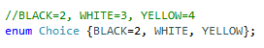
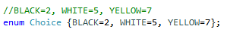
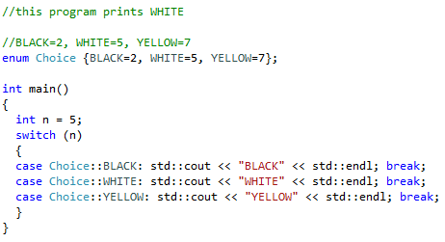
Enums
You can even specify which numbers should be associated with which value:
Using enums with a switch:

Slide 34
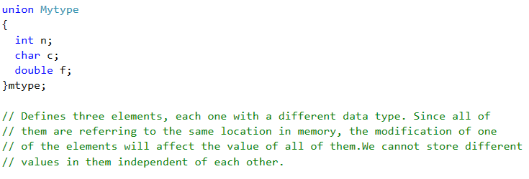
Unions
The purpose of union is to save memory by using the same memory region for storing different objects at different times.

Slide 35
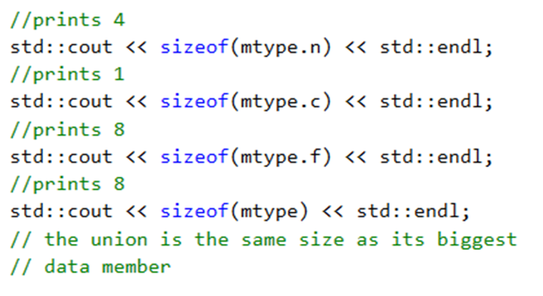
Unions
The size of the union is the size of its largest member.
Only one member can be active at any time.
You can make a member active by writing on it.
You can write to one kind of data type member and inspect it using another. This causes undefined behavior.

Slide 36
References
To read/view
https://www.cplusplus.com/doc/tutorial/control/
Video tutorial:
From C++ Tutorial for Beginners 25 – Functions Using Subroutines in C++
To C++ Tutorial for Beginners 28 – Headers and Prototypes

Slide 37
Contact
Published by Siemens 2023
Ionuț Verzea
Software Engineer ADV D EU RO IFA MI
Blv. 15 Noiembrie Nr.78 500097 Brașov România
E-mail ionut.verzea@siemens.com
Petrescu Vlad Adrian
Software Developer ADV D EU RO ES TLS DI1
Blv. 15 Noiembrie Nr.78 500097 Brașov România
E-mail vlad.petrescu@siemens.com

